Slide 1

2017 Devon IT Hackathon
Danny.Burrows
Don.Morrison
Steve.Pankratz
Jon.Slominski

Slide 2
Problem Statement / Introduction
Completions visualizations for the field
What nobs can PIC turn?
Rate
Chemical Concentration (gel, FR)
Sand concentration
What moves the needle?
Time pumping
Horsepower brackets
Water useage

Slide 3

Tools
.NET Core / .NET Standard
Azure Event Hub
Azure Search
Azure ML Studio
Azure Storage
Angular
Serilog
Application Insights
Visual Studio Team Services
Slack

Slide 4










Flow
Engineering limits
Azure SQL
BI/Reporting
PI Historian
Contracts
Pump Schedule
Event Hub
Event Hub
Responsive Web App
Streaming API
Addl. Data Integrations
Azure Stream Analytics

Slide 5
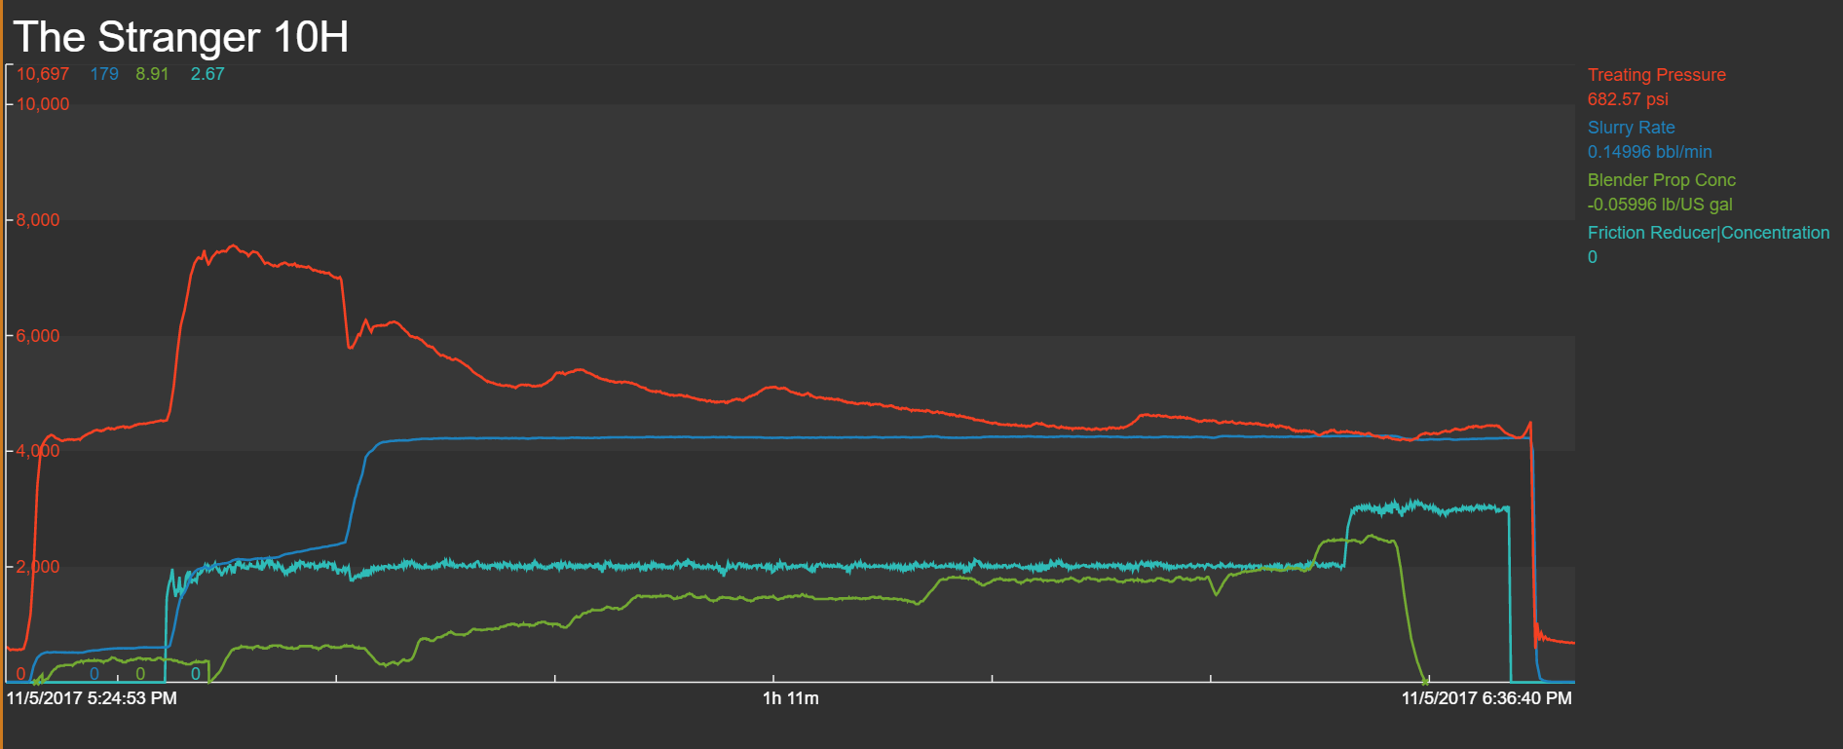
Stage Example

Slide 6

Leaderboard
FRAC LEADER BOARD
1
JOHNNY G.
2
JIMMY T.
3
DRAGON
4
BIG BEARD
5
CHARLES P.
6
STRANGER PIC
7
A GEOLOGIST
SHARE

Slide 7
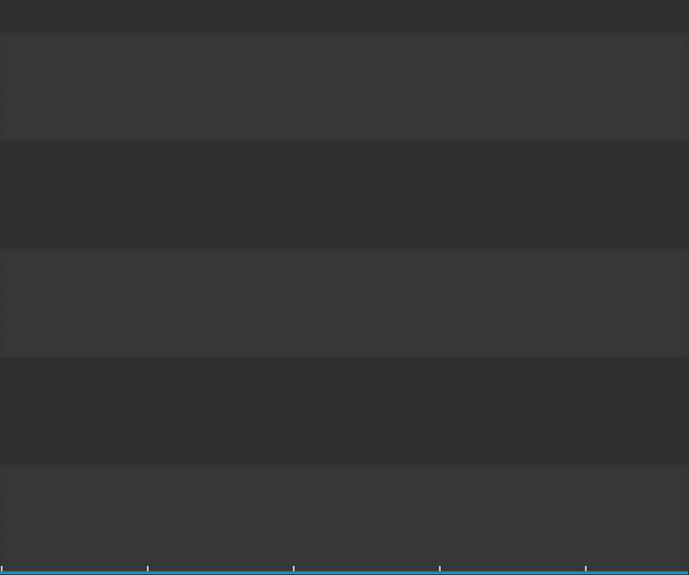
Time to Take Action

Slide 8
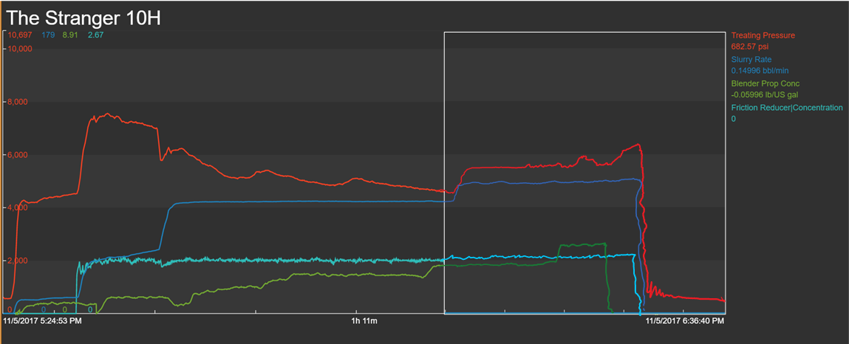
Result of Action
New, higher rate decreases stage time by 1.5 minutes

Slide 9
Leaderboard
FRAC LEADER BOARD
1
JOHNNY G.
2
JIMMY T.
3
DRAGON
4
BIG BEARD
5
STRANGER PIC
6
CHARLES P.
7
A GEOLOGIST
SHARE

Slide 10
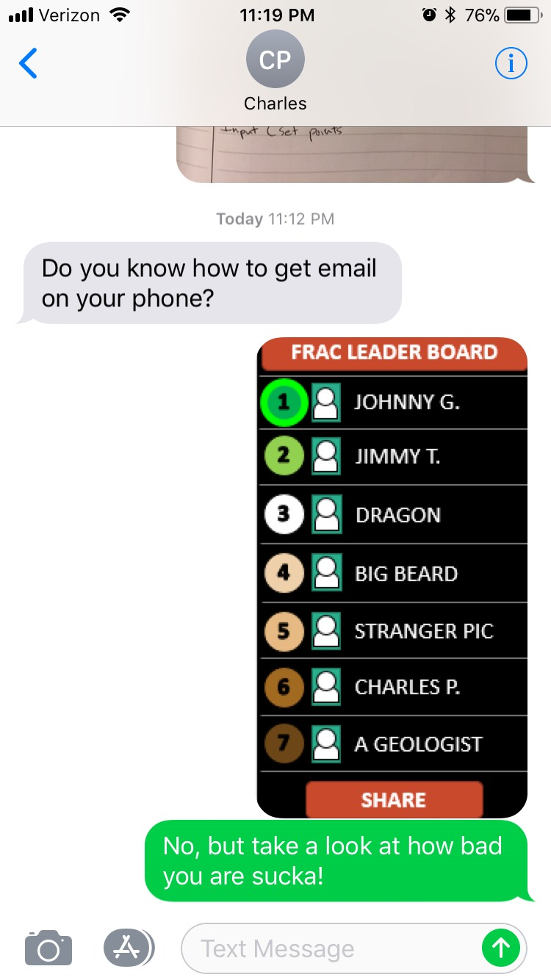
Leaderboard
FRAC LEADER BOARD
1
JOHNNY G.
2
JIMMY T.
3
DRAGON
4
BIG BEARD
5
STRANGER PIC
6
CHARLES P.
7
A GEOLOGIST
SHARE

Slide 11



So What?
Increasing rate by 5 bpm during last 3rd of the stage yields stage 1.5 min faster
$$Time Saved\left(hr\right)∗(Fixed Hourly Rate \left(\frac{\$}{hr}\right)+Variable Rate (\frac{\$}{hr})$$
$$\frac{1.5}{60}∗\left(\$5,100+\$10,640\right)=\frac{\$393}{Stage}$$
$$\frac{\$393}{Stage}∗\frac{10 Stages}{Day}∗\frac{255 Days}{Year}=\frac{\$1 MM}{Year}$$

